Slide 1
ALEX: An Updatable Adaptive Learned Index

Slide 2
BACKGROUND & MOTIVATION

Slide 3
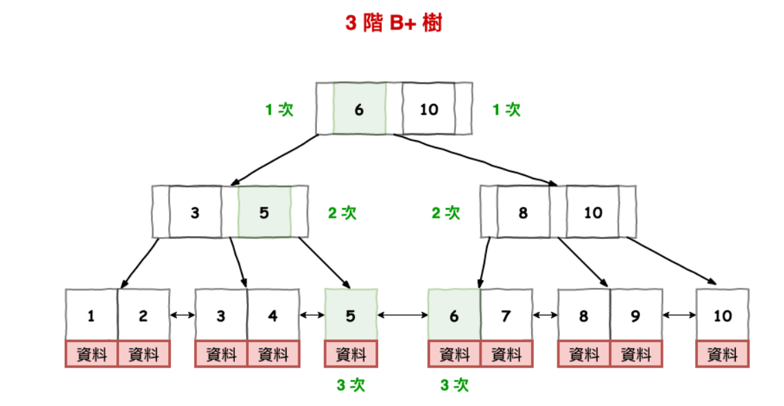
Traditional B+Tree Indexes
Problem: doesn’t make use of the knowledge of the relation between data.

Slide 4
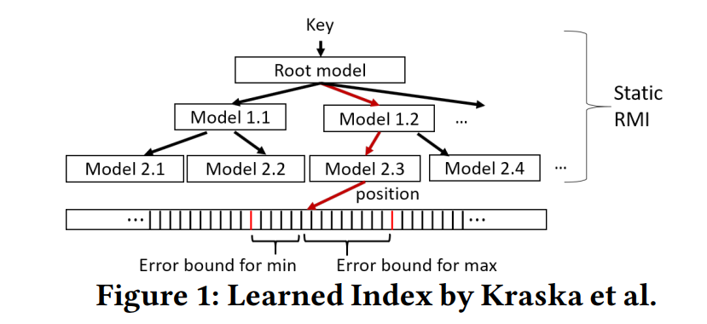
The Case for Learned Indexes
RMI(recursive model index) replaces the internal B+Tree nodes with models.
Drawback: does not support any modifications (O(N) is too slow)
Notes:
Root 使用哪種model (linear regression / neural network): 看誰比較好??
Non-root: linear簡單(儲存變數少) 計算少 y = a∗x +b 取lower bound

Slide 5
METHODOLOGY

Slide 6
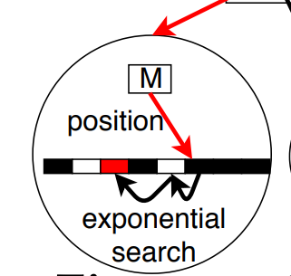
Data Nodes (leaf nodes)
Model, including two double values
2 Gapped Arrays for keys and payloads
(+ bitmap)

Slide 7
Data Nodes (leaf nodes)
The gaps are distributed between by model-based inserts, instead of at the end of the array.
Gaps are filled with the closest key to the right of the gap for exponential search.
Bitmap: for distinguishing keys and gaps

Slide 8
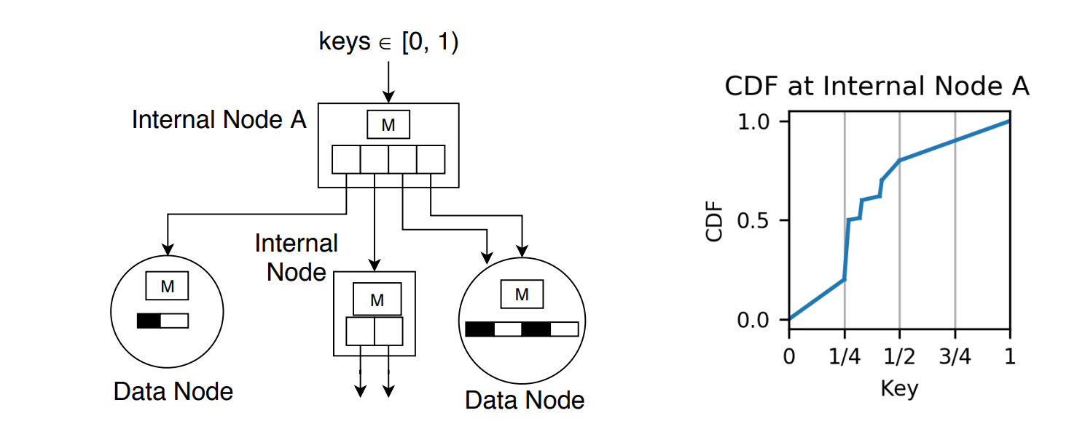
Internal Nodes
Model, including two double values
array containing pointers to children nodes

Slide 9
Internal Nodes
Internal Nodes assign a Data Node or another Internal Node for pointer according to the CDF. (Data node for linear interval)

Slide 10
Algorithm: Insert in full Data Node
“Full”: if the next insert results in ratio > du (default dl=0.6, du=0.8)
Use simple cost models to calculate expected cost.
Factors:
average number of exponential search iterations -> average log₂error
average number of shift for inserts -> average distance to the closest gap
Compare empirical cost and expected cost to decide doing expansion or splitting when the data node is full (whether current model still works)
Notes:
lower and upper density limits
Search成本跟insert成本
當insert的新資料不符合現有資料的分布，會導致model變得不準，會有很長一段沒有gap，insert效率變得很差O(N)

Slide 11
Algorithm: Insert in full Data Node
Expansion:
Allocate a new larger Gapped Array with n/dl slots (n: number of keys in current array).
Scale or retrain the model, and then do model-based inserts of all the elements.
Notes:
Assign bigger space 全部重放

Slide 12
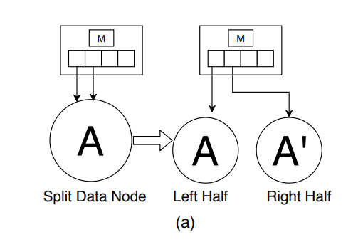
Algorithm: Insert in full Data Node
Splitting slideways:
If the parent internal node < max node size: half of the redundant pointers for each (double the array and copy every pointer if needed)
Notes:
分出來的兩個各一半
如果指到原本的只有一個，直接把原array複製一份，兩個各一個

Slide 13
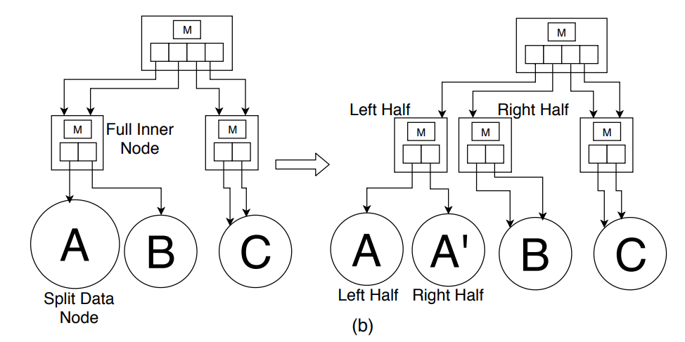
Algorithm: Insert in full Data Node
Splitting slideways:
If the parent internal node = max node size: split the parent internal node
Notes:
lower and upper density limits

Slide 14
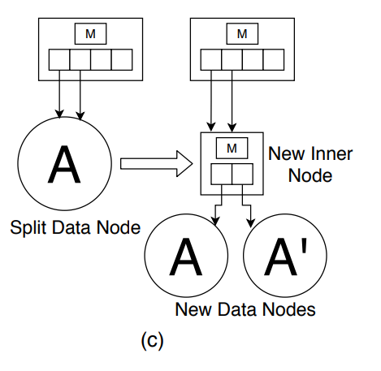
Algorithm: Insert in full Data Node
Splitting down:
converts a data node into an internal node with two child data nodes.
Notes:
lower and upper density limits

Slide 15
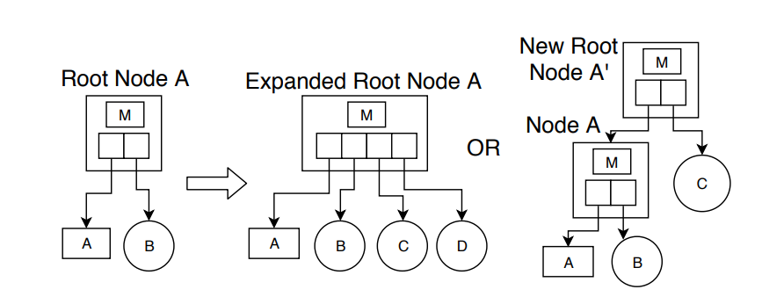
Algorithm: Out of bound insertion
Notes:
Root pointer array直接*2，新增的全部指到data node
如果不能*2，創一個新的root，第一個pointer指向舊root，剩下所有新的都指向data node

Slide 16
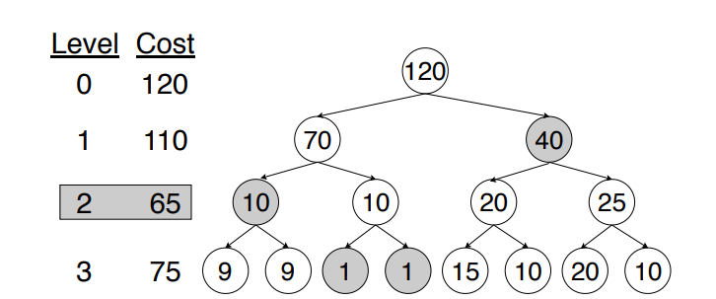
Bulk Load at initialization
Start from root, find local minimum of cost sum and decide to divide or combine nodes one by one .

